Slide 1
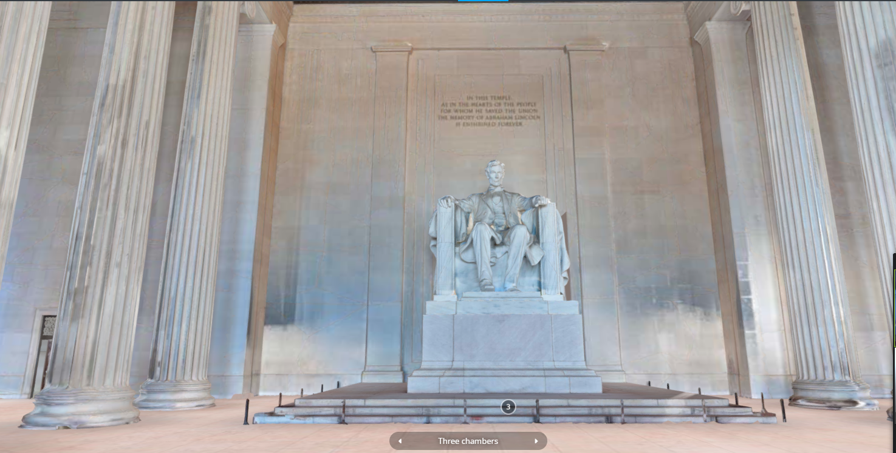

Slide 2
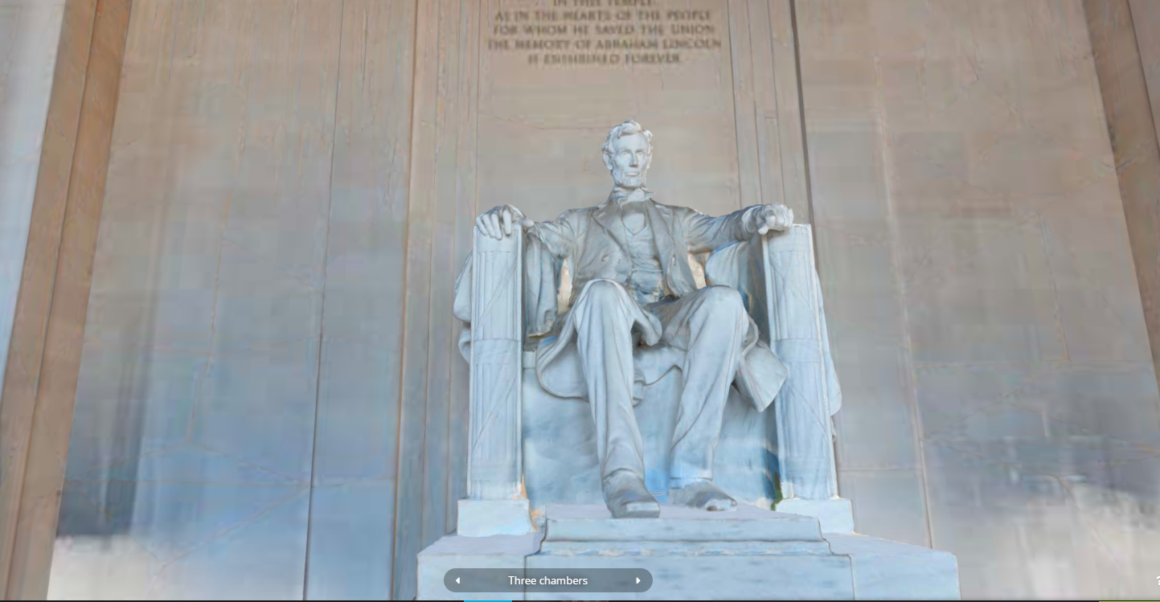

Slide 3
What question does this prototype ask (what idea does it test)?
Engaging, measurable knowledge learning experience
Easy navigation, more realistic experience (replicate an in-person experience)
Are students able to socially connect and engage with each other through these interactions in meaningful ways as they were able to during in-person field trips?
What is the biggest risk with this prototype (what might make this idea fail)?
Not being able to log-in, single time use, only tracking the progress for a single time visit
Not being able to capture
123

Slide 4
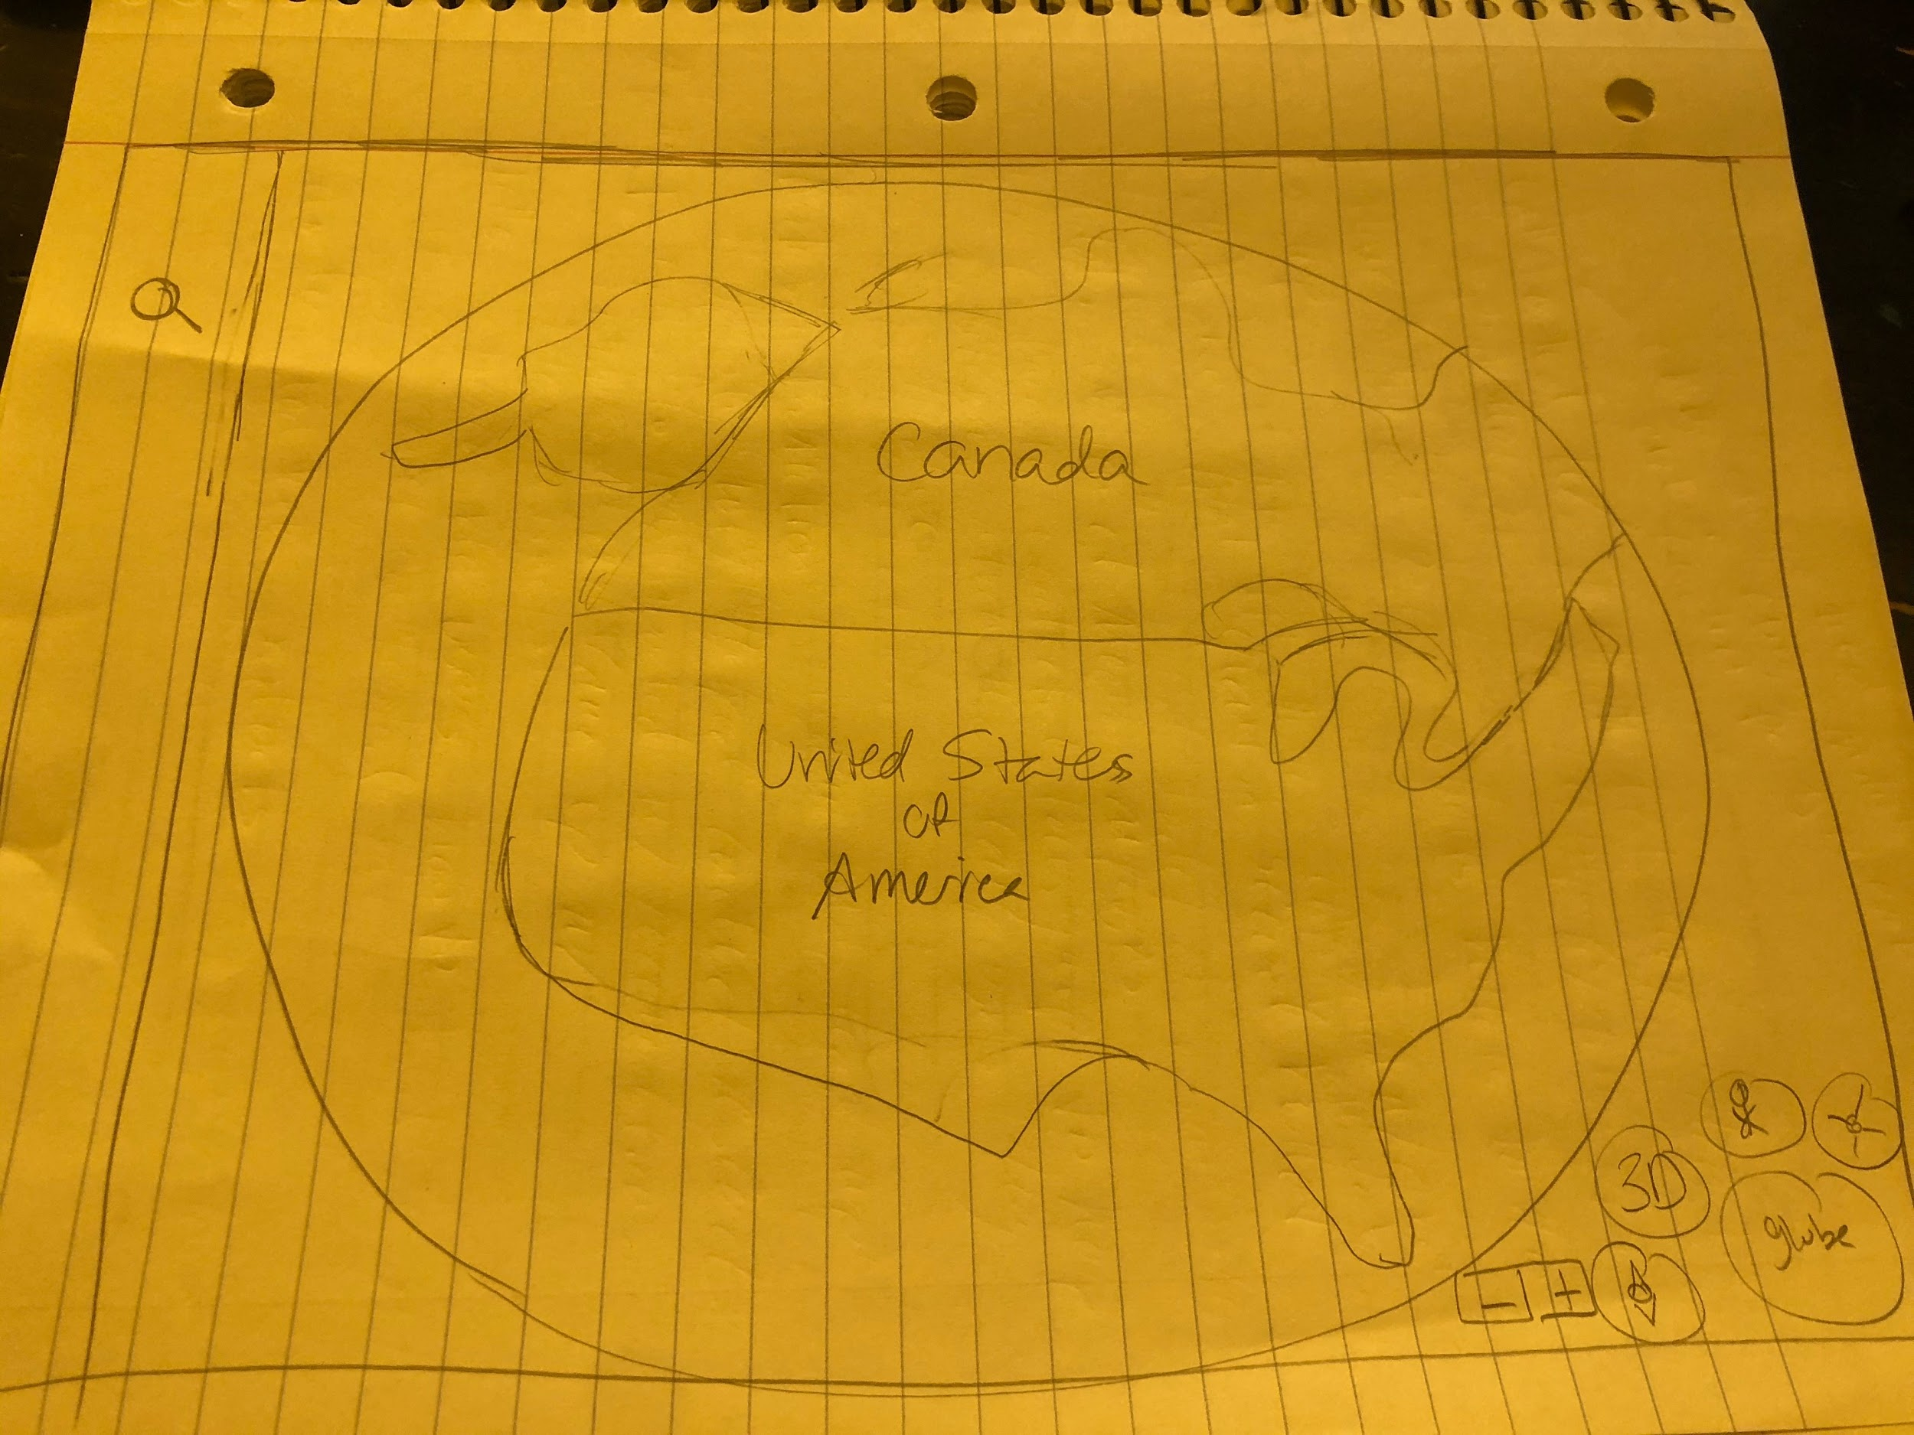

Slide 5
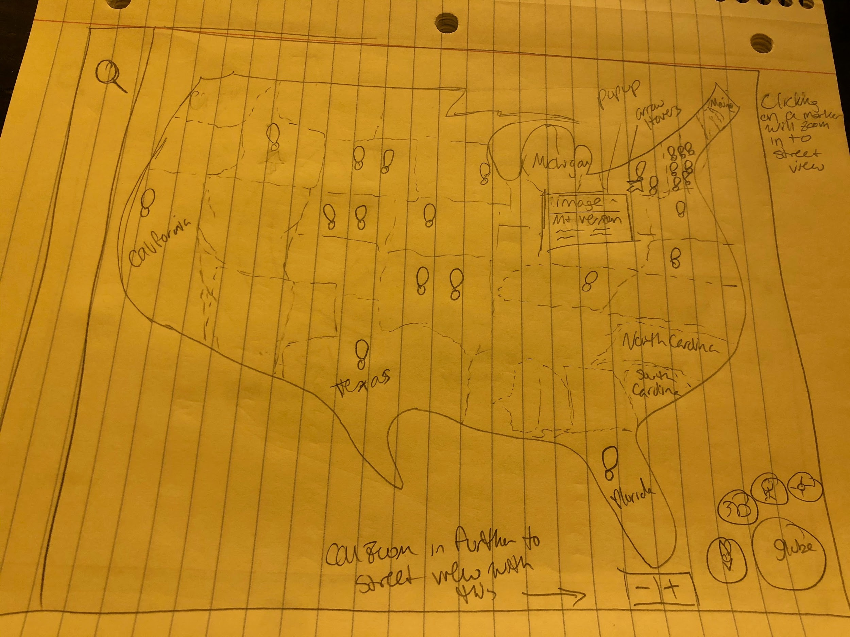
Clicking on a marker will zoom in to street view
Can zoom in further to street view, you can use the + or - to zoom out

Slide 6
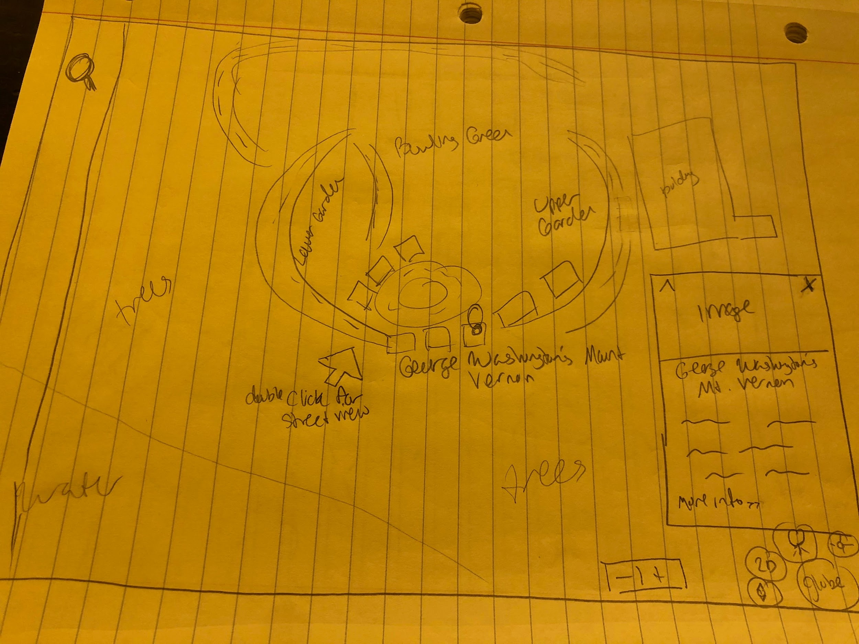
Preview of summary will pop up as you get closer
Double click for street view

Slide 7
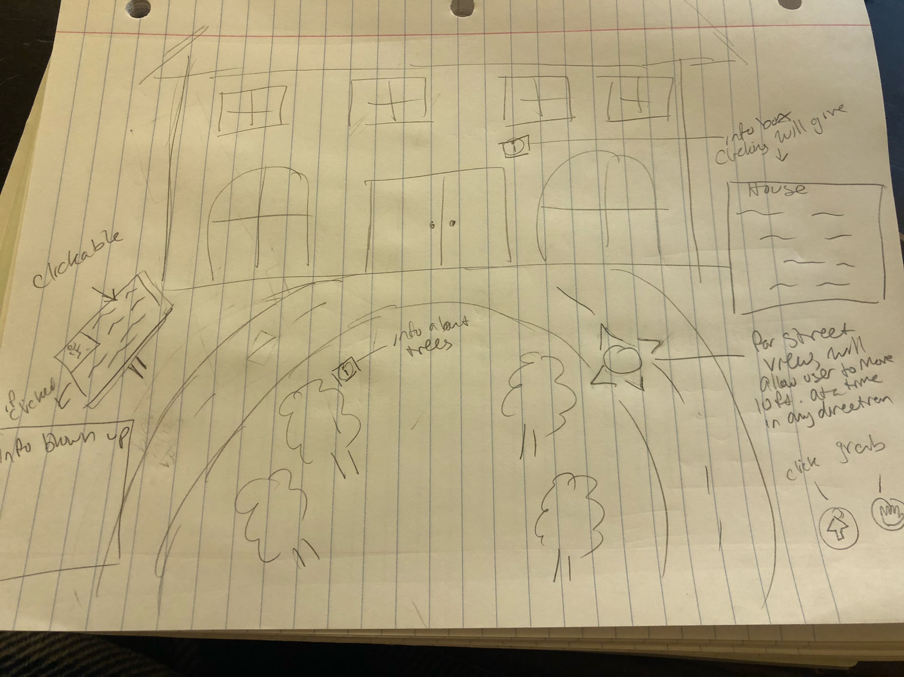
Info boxes and plaques are clickable, summaries/info will pop up in separate boxes
I can’t draw the street view, but for the street view there will be arrows on the ground to allow user to move 10 ft at a time in any direction

Slide 8
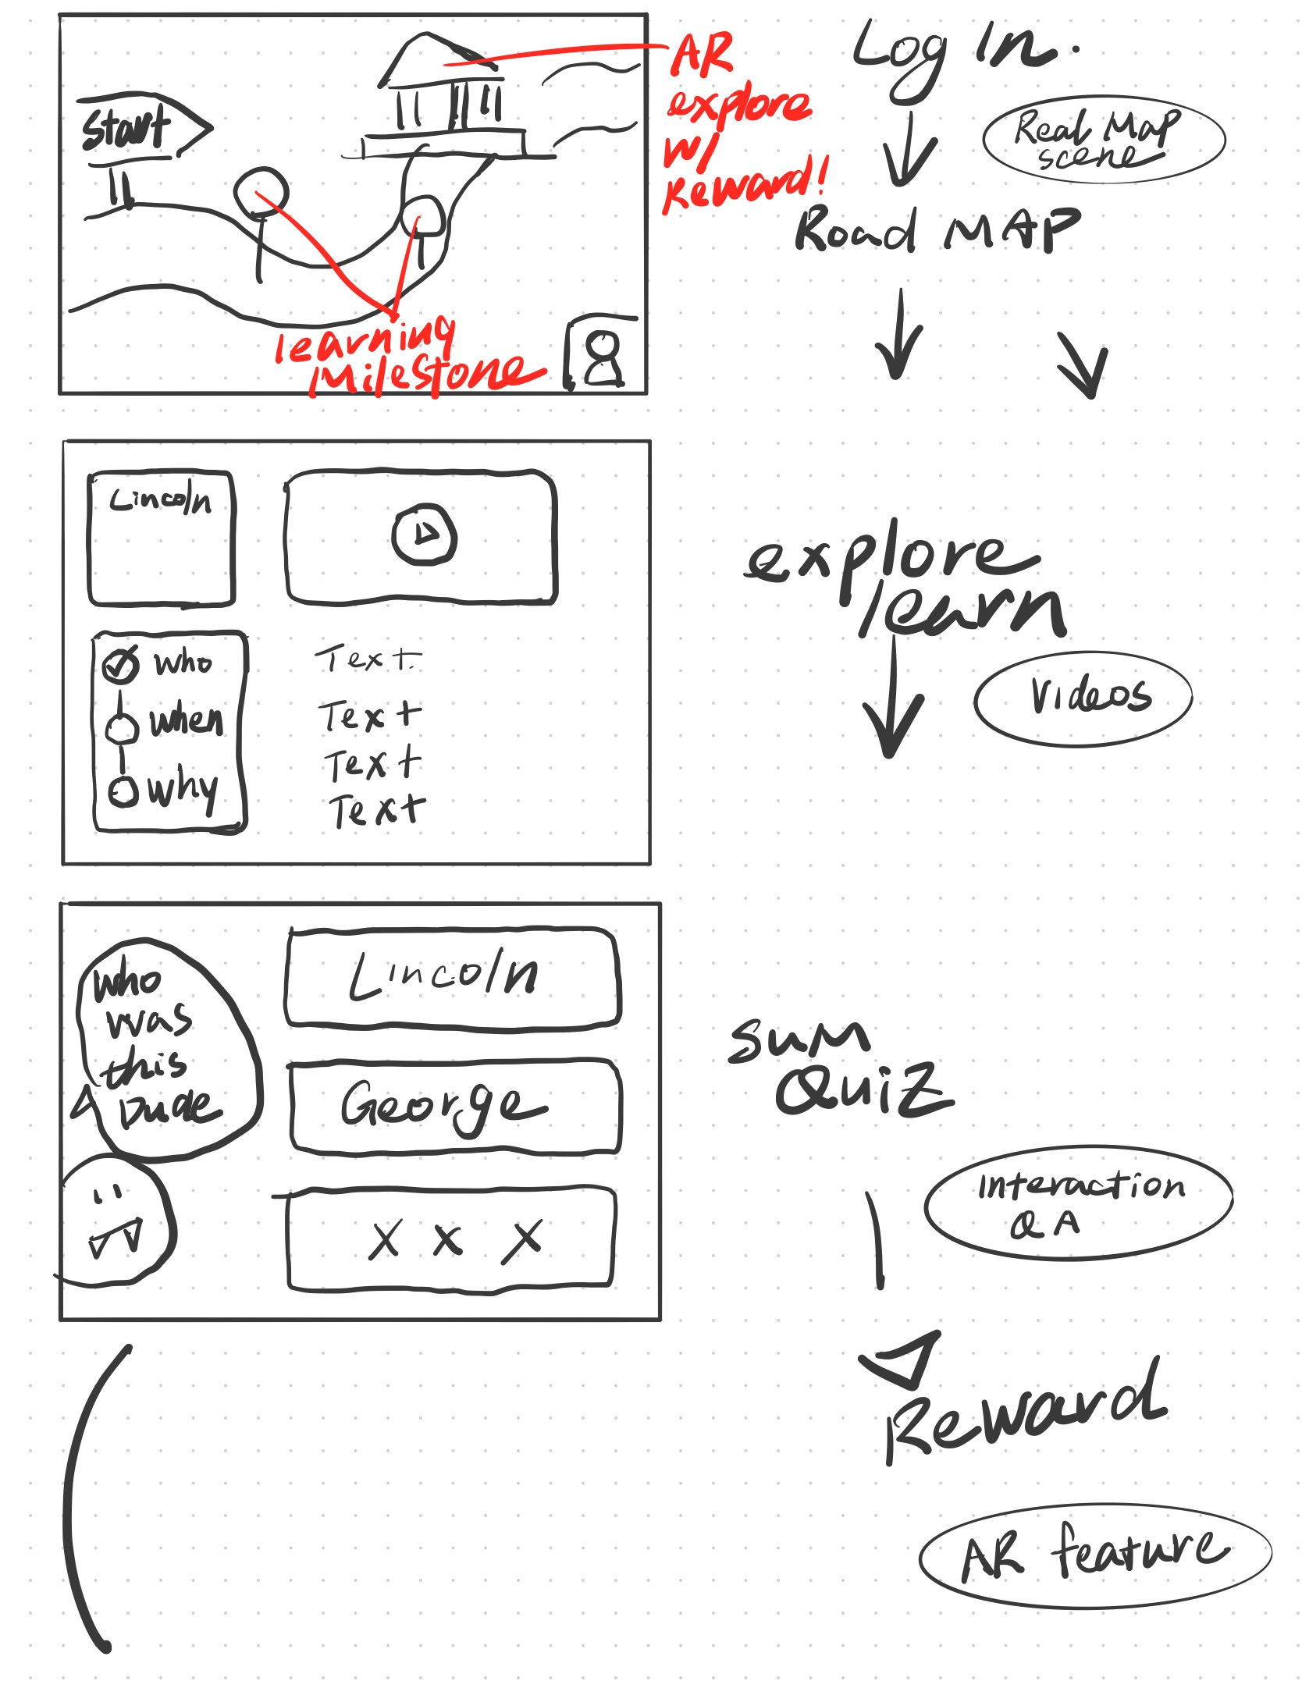
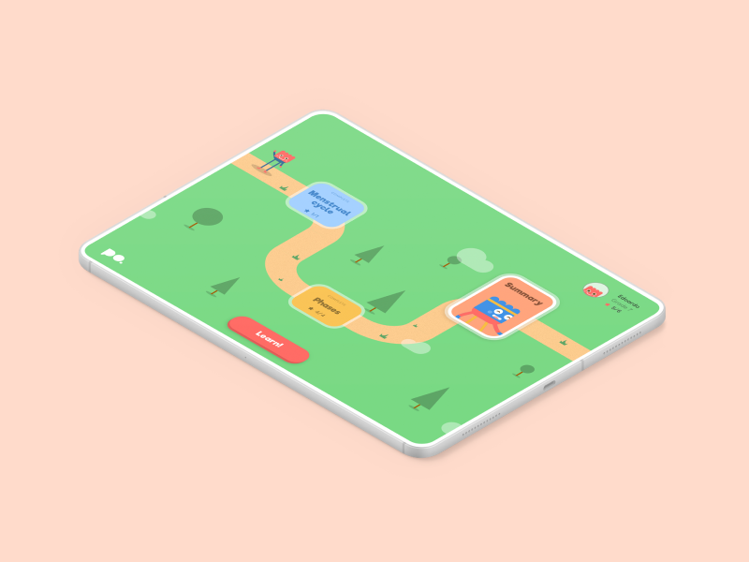
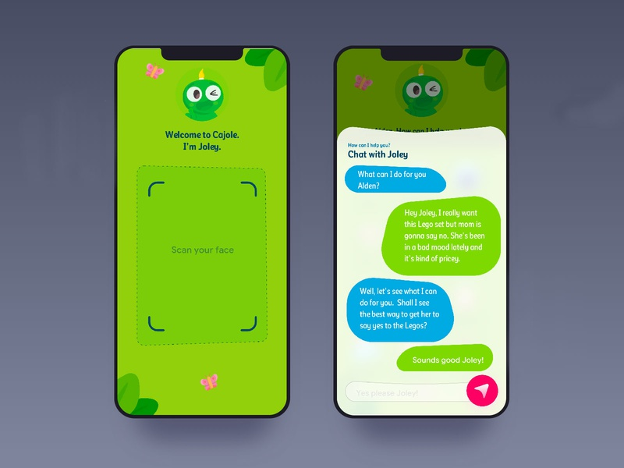
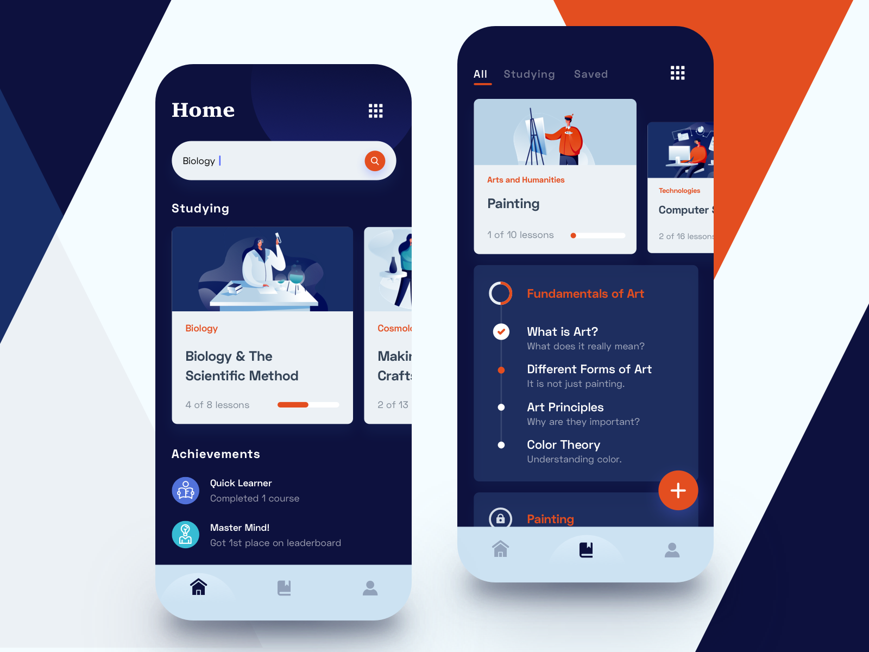

Slide 9
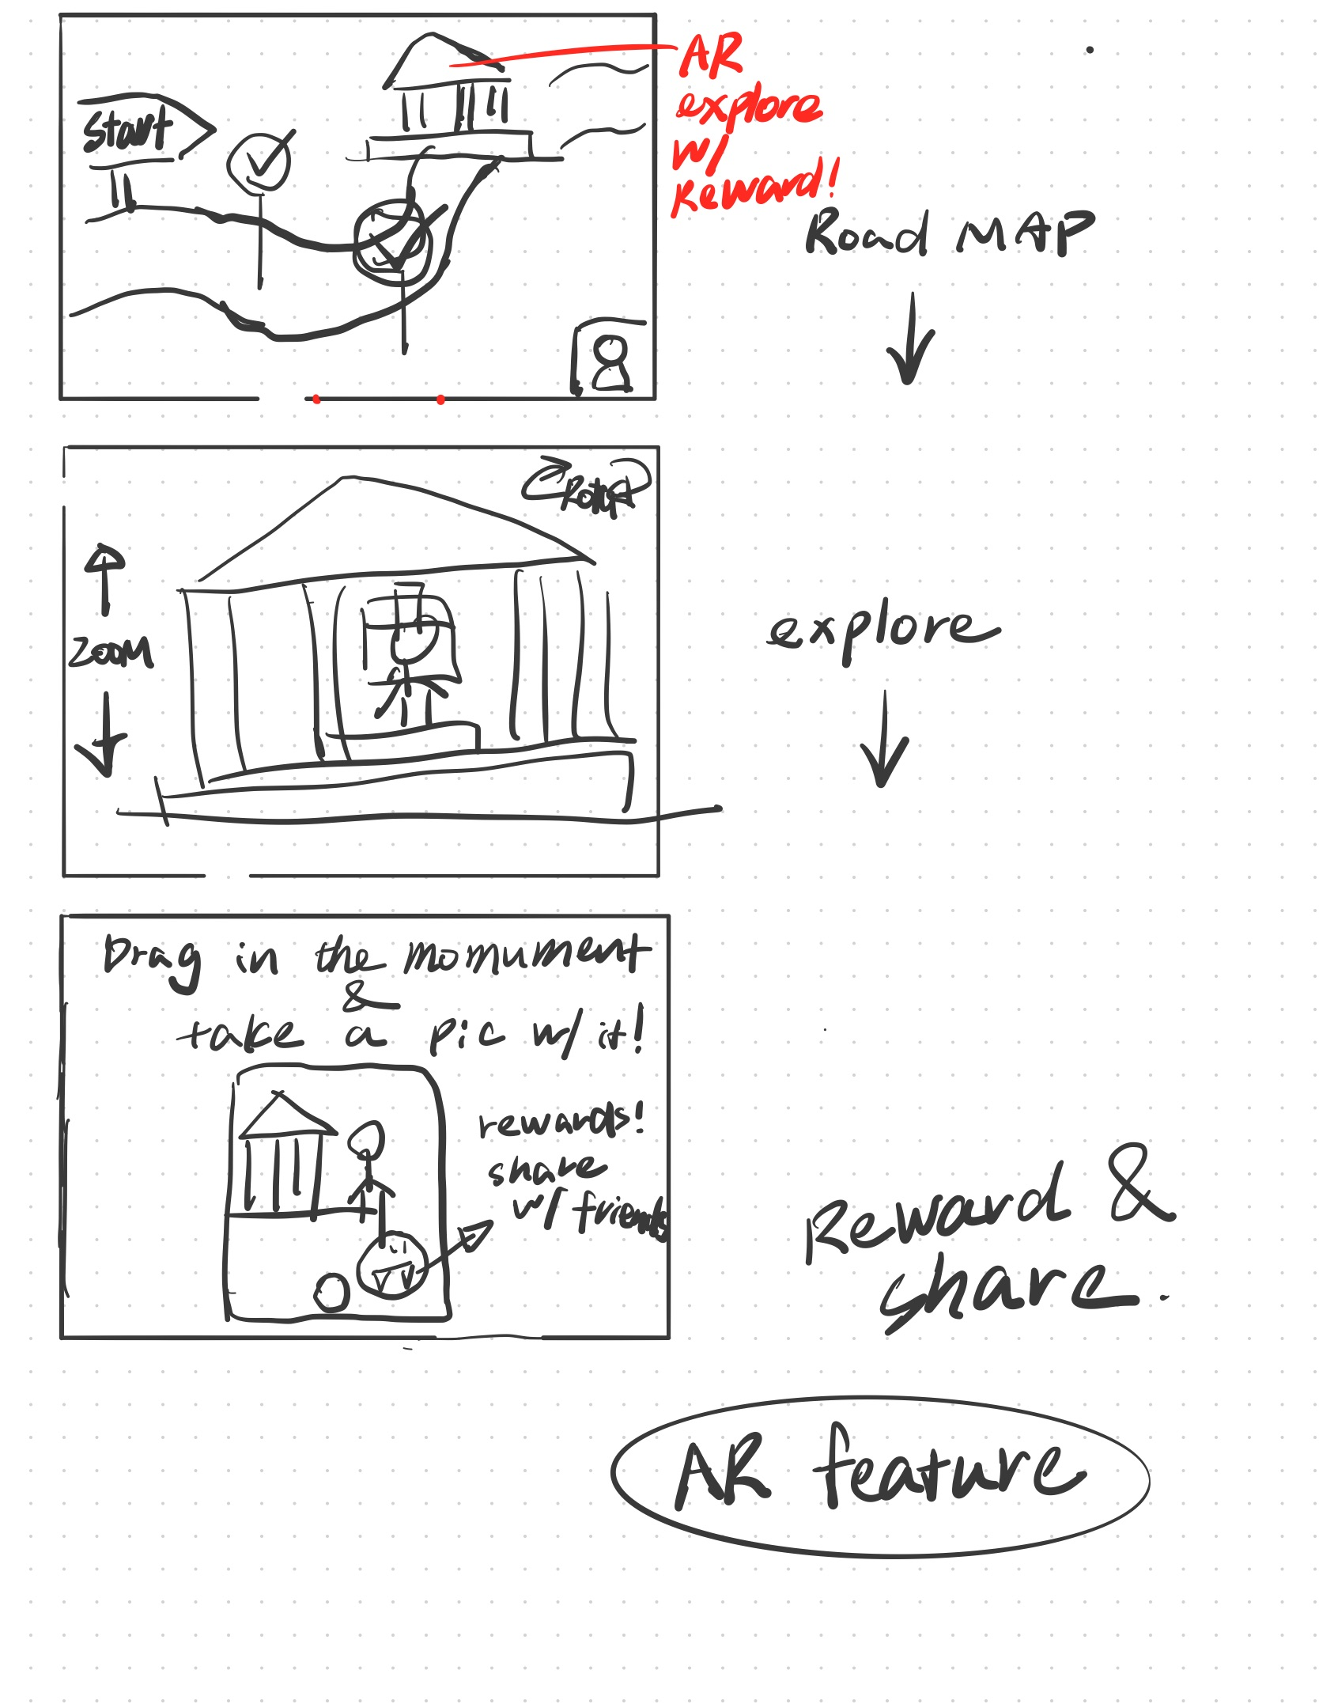
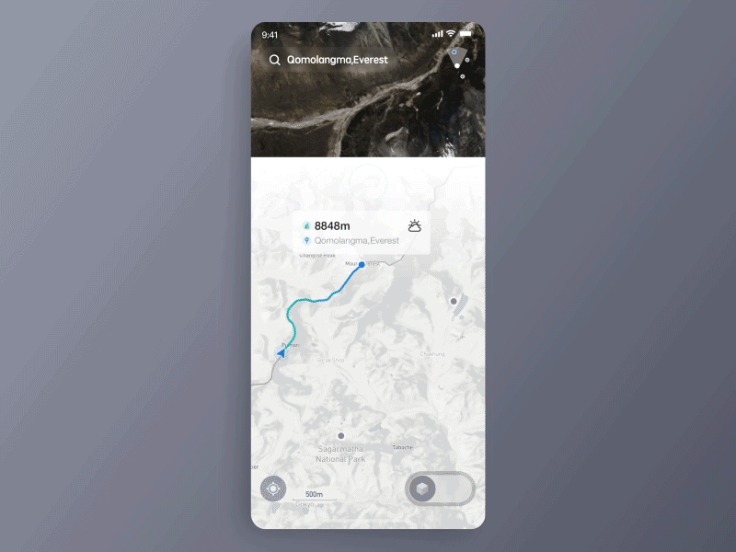
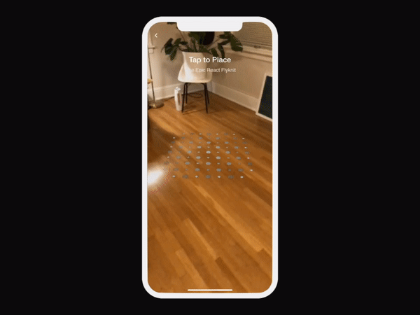

Slide 10
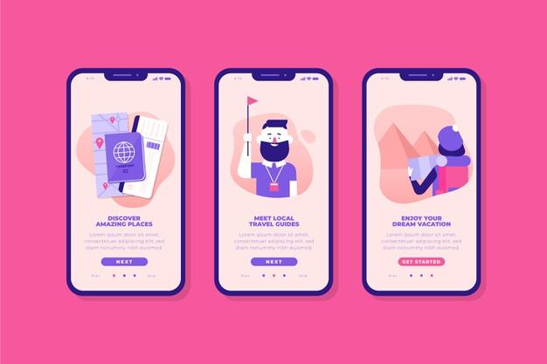
Login page?

Slide 11
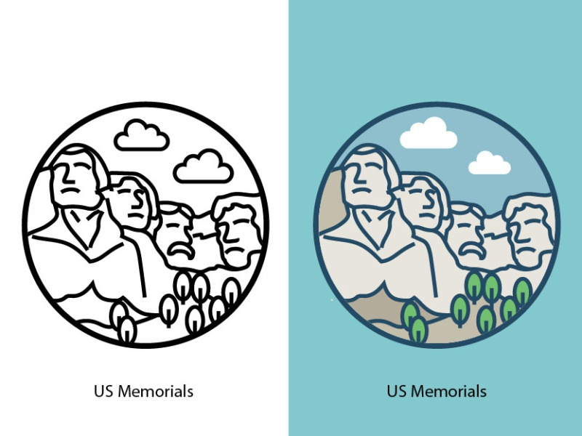
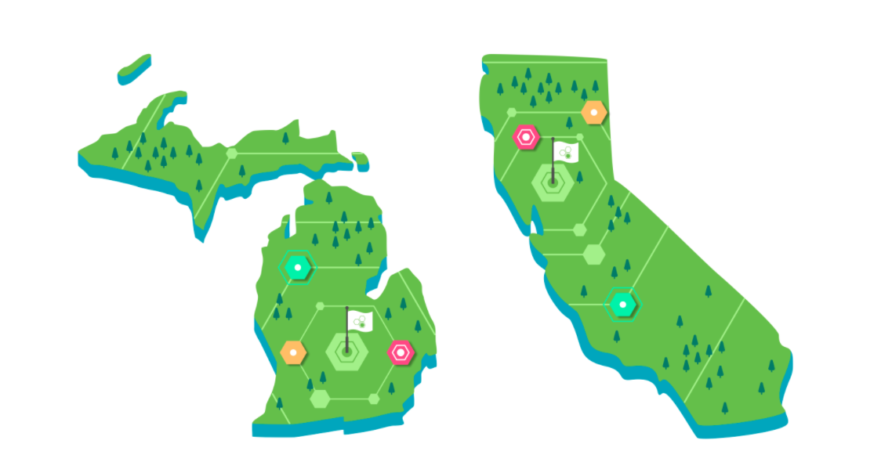
Roadmap/home page/badge reward design

Slide 12
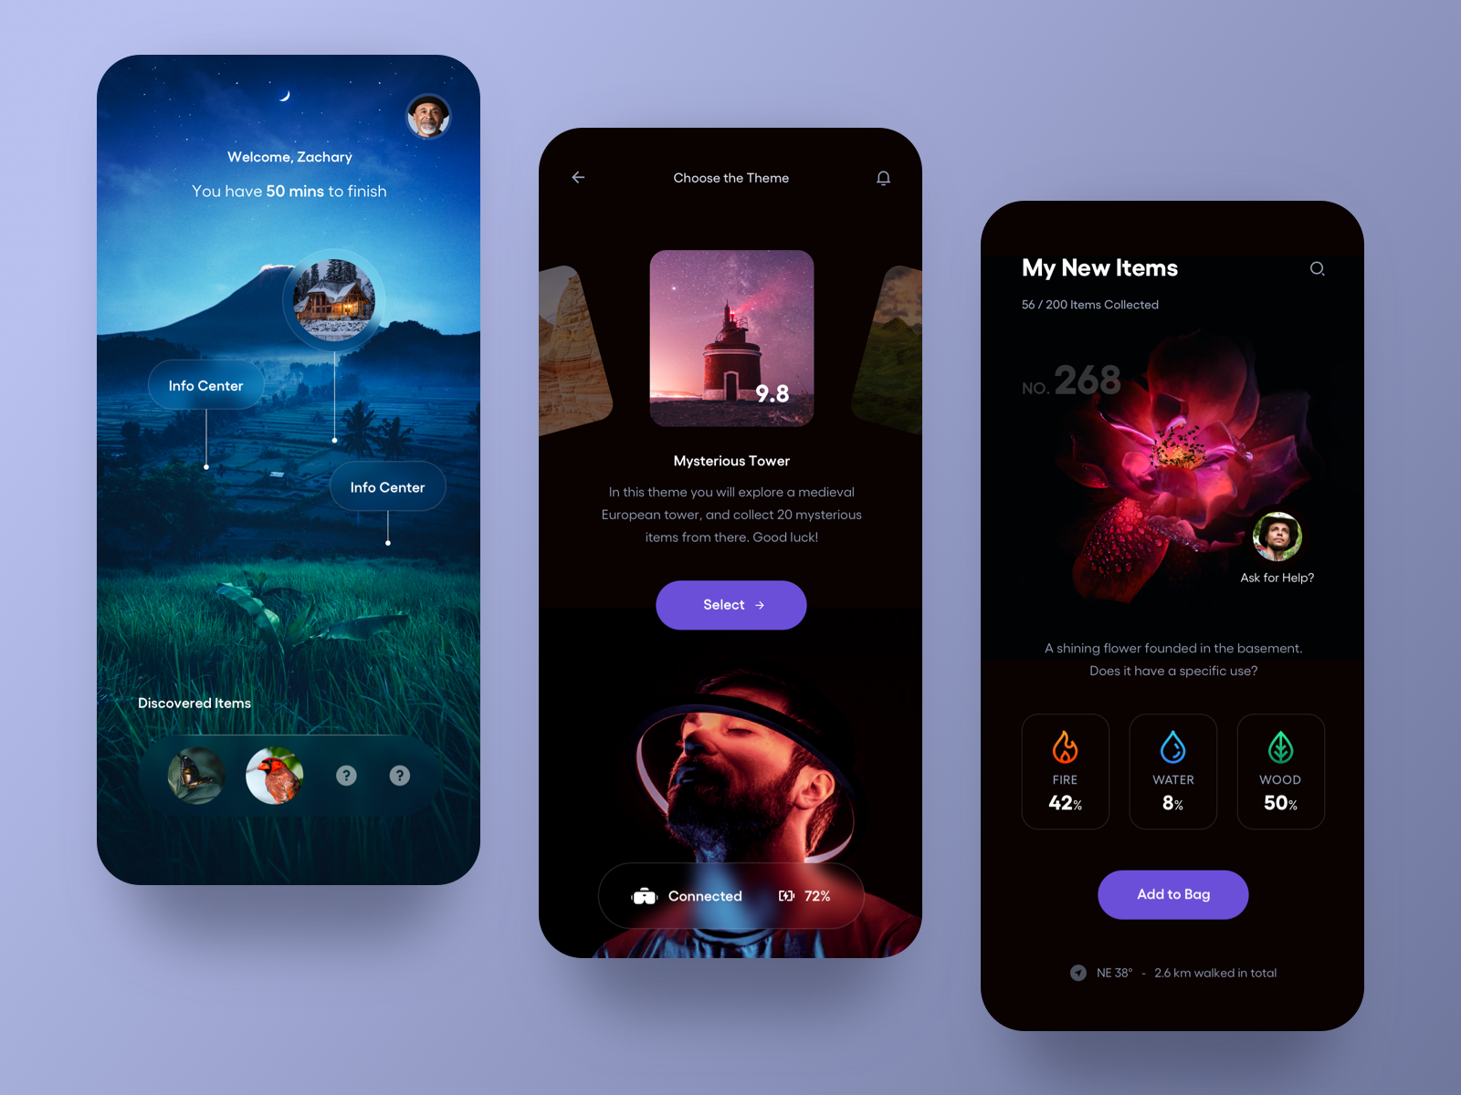
Roadmap alternative design

Slide 13
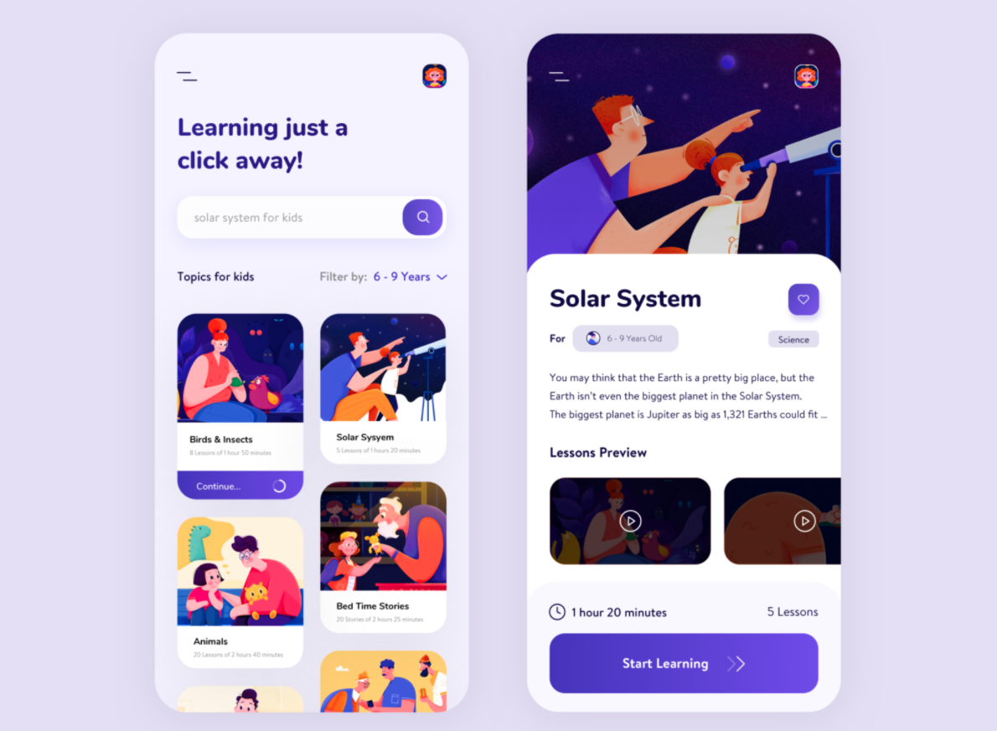
The learning journey about the monument; we take the text dense information about the monument and turn it into digestible format for students to learn
Videos/audios
Text and stories

Slide 14
Interactive QA on the monument
An easy summary on the information you just explored previously.
To earn reward with your imaginary friend and unlock the AR photo and Realworld 3D explore feature

Slide 15
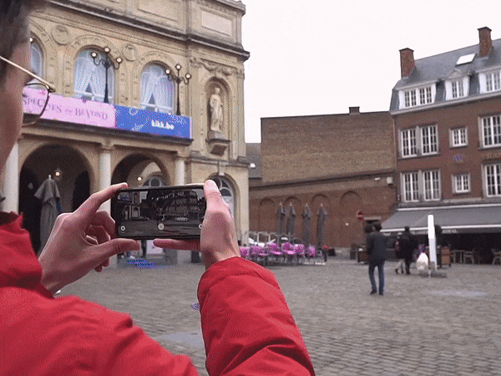
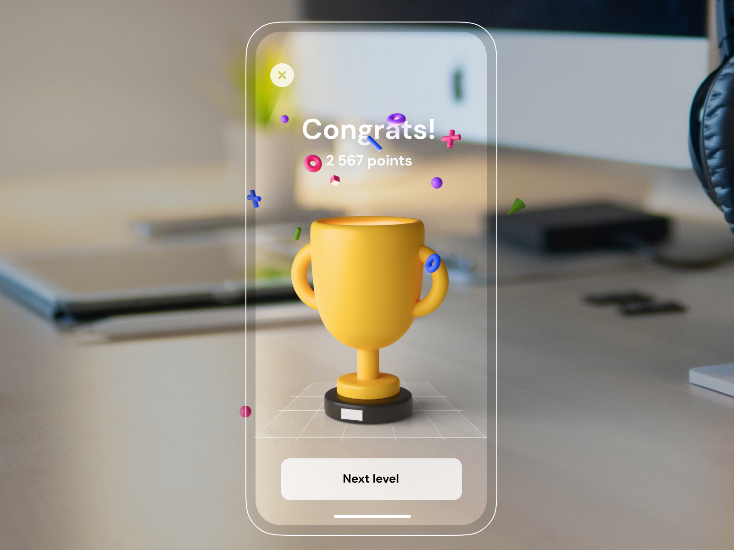
AR reward
Social sharing features
Taking pic with the monument, and see it in real time

Slide 16
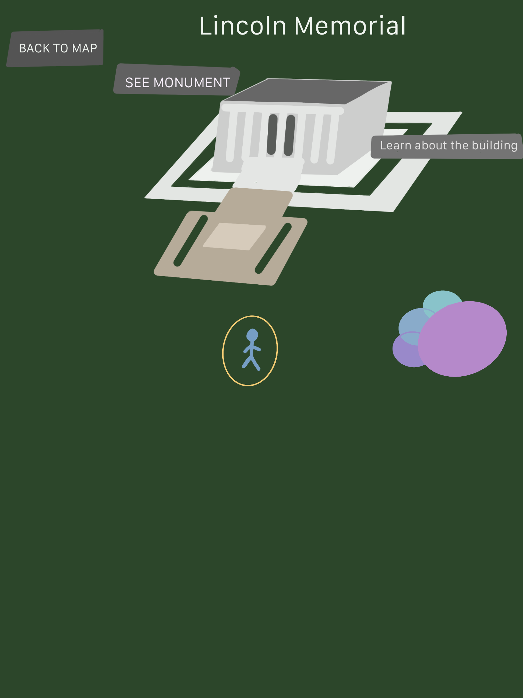

Slide 17
